Slide 1
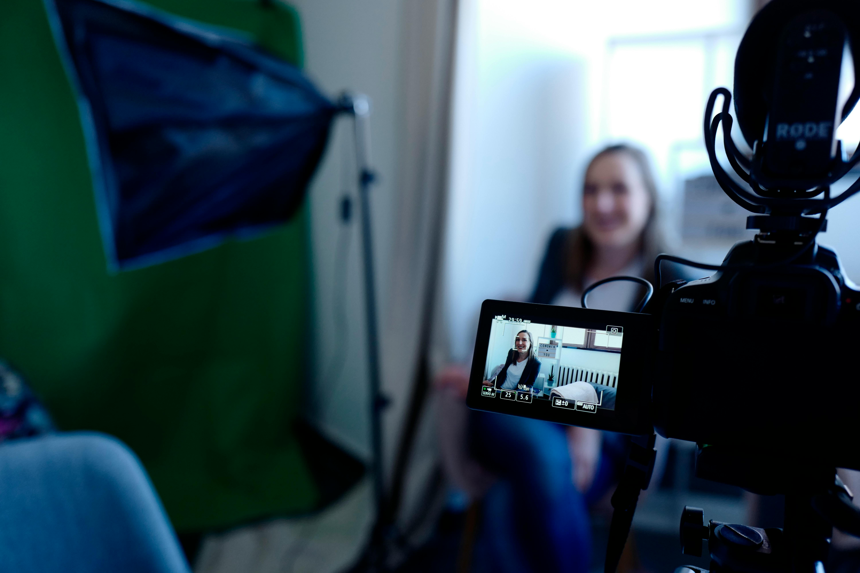


Put on your producer hat: considerations for FAIR video material
Module 6 – FAIR Training Material by Design
September 18-19, 2024
Kristen Schroeder

Slide 2
Learning outcomes for this session
Describe the advantages and challenges of video media in FAIR training
Understand active and responsible AI usage in creating FAIR video materials
Find video materials to use in FAIR training
Annotate video material to make it FAIR
Apply FAIR video materials to your training delivery system

Slide 3
Part 1: What are video training materials?
Just like research data, any publicly funded video training material should be FAIR to enable its discovery, evaluation & reuse.
Recorded interviews
Podcasts
Stock footage with reuse licenses
Open lectures
Zoom recordings
Webcam or smartphone footage
Screen recordings
Professional studio recordings
Powerpoint slideshows
Voiceovers
Livestreams

Slide 4
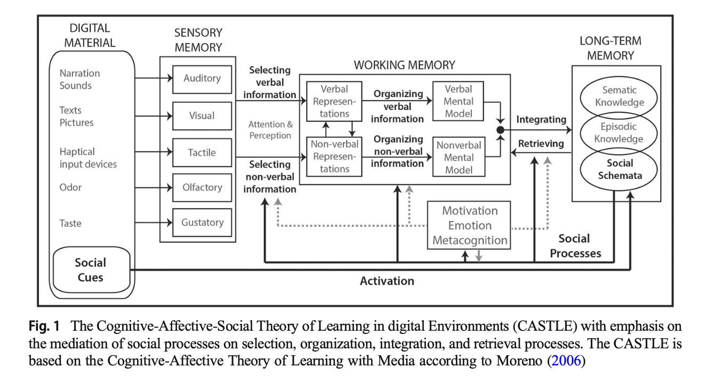
Part 1: Why do we care about having FAIR videos?
Video material…
assists in asynchronous learning by adding more dimensions to the learning experience
increases access to knowledge by removing location and time barriers to experts
assists synchronous learners in resurfacing their knowledge after the course is complete
links important context with knowledge being shared
makes use of a primary communication media
Video media is a great tool for enhancing & contextualizing learning!

Slide 5

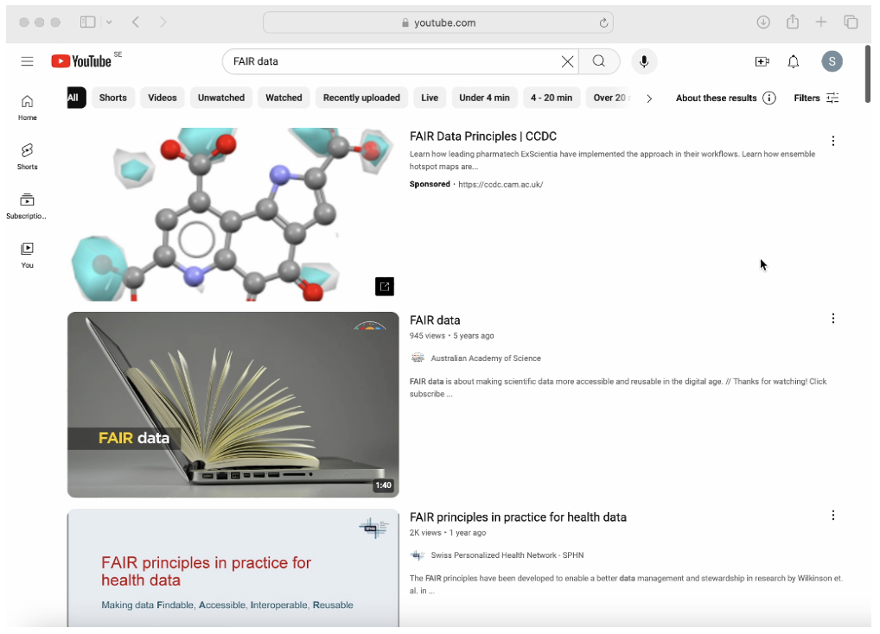
Part 1: Why do we care about having FAIR videos?
video content ≠ learning material
however…
(Actual picture of a person nagivating the content cloud)
Your video learning material will exist within the content cloud

Slide 6

Part 1: Why do we care about having FAIR videos?
if video content ≠ learning material
Where to find expert input or community for schema testing
Constructive alignment with discussions and exercises
Metadata record
what’s the difference?
Zoom recording of my amazing lecture!!!!
Like and subscribe :D
Explanation of how stress influences protein folding by a PhD who studied it in a lab for 5 years
Online course delivery
IL
Cool science guy
SciLifeLab Training Hub
Doi: xxx
Author: Cool science guy
Transcript:
This lecture is a part of the course Stress 101 delivered in December 2034 at Stockholm University. Hello and welcome to this short lecture on…
Video learning materials need FAIR metadata to place them in the appropriate context to be understood by both humans and machines.

Slide 7

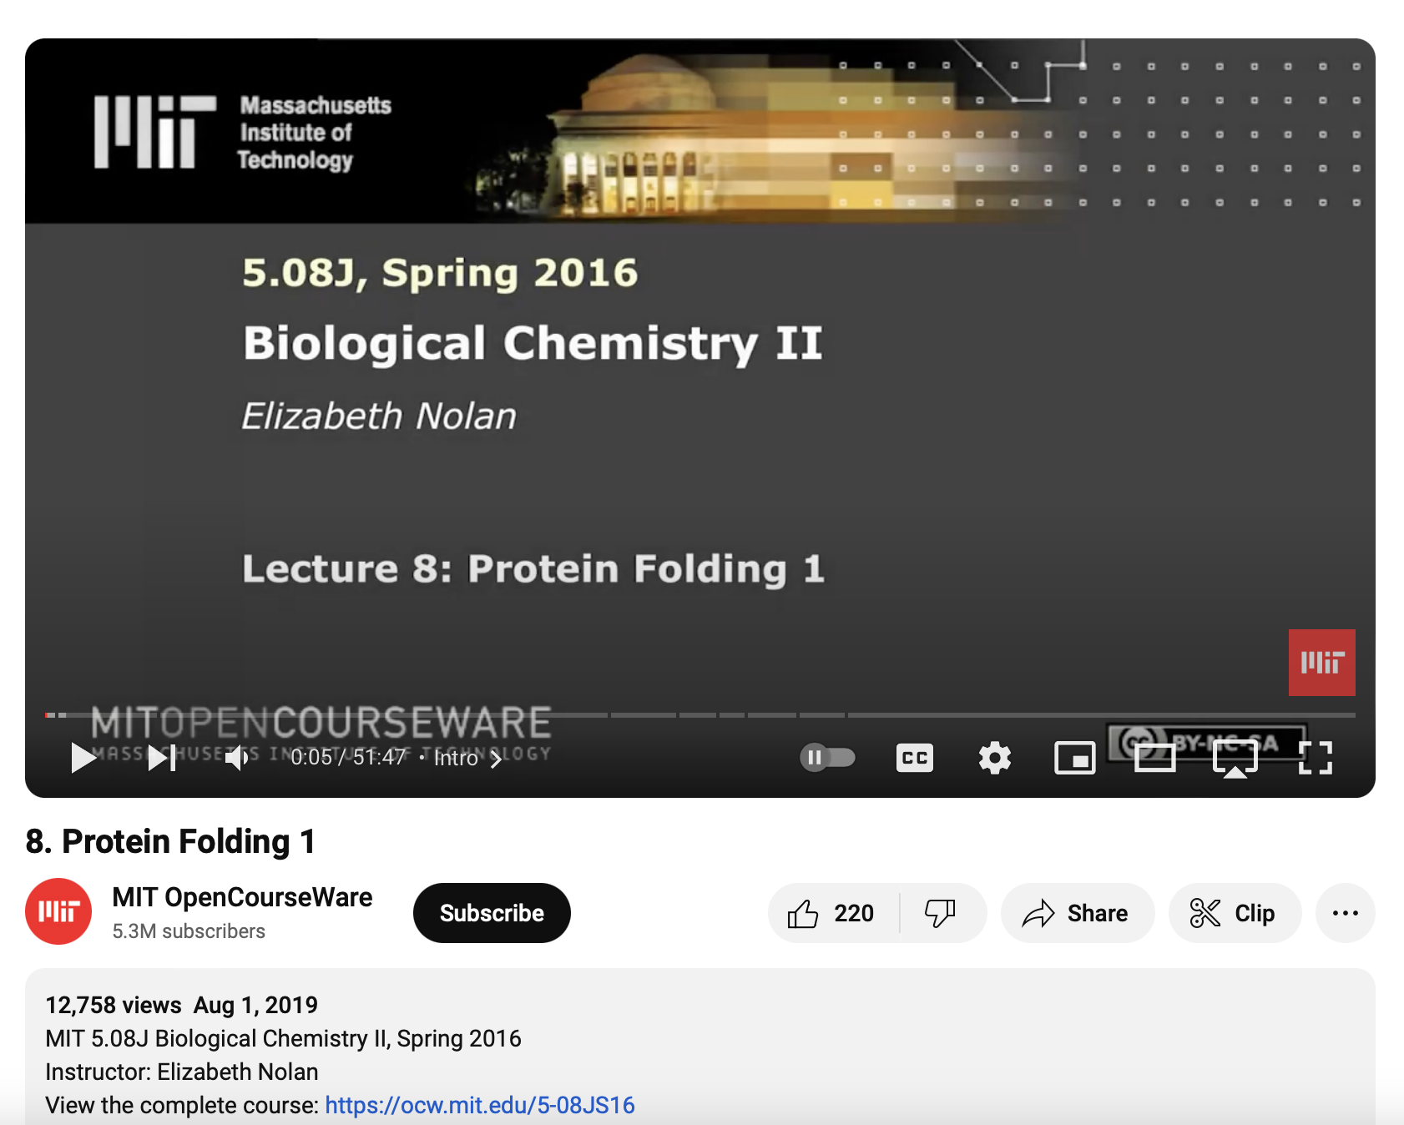
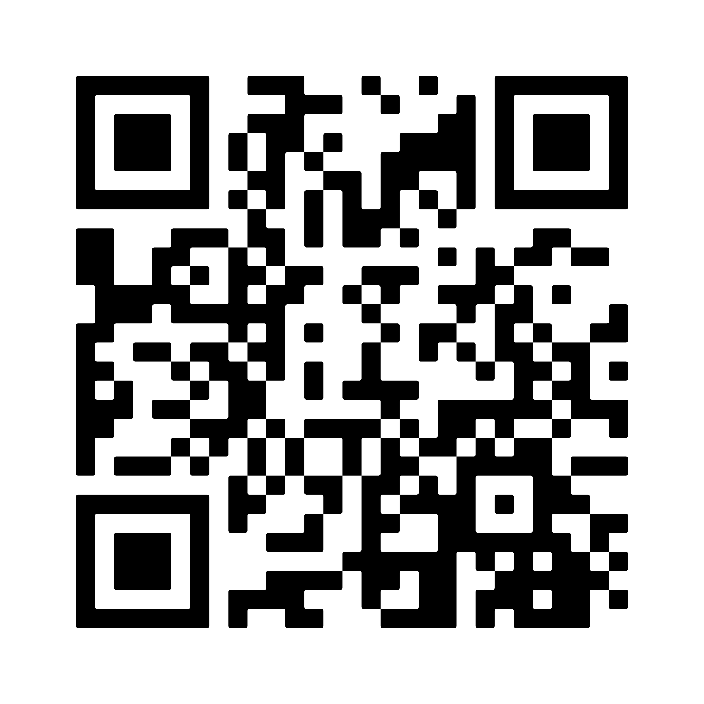
Part 1: Example #1 – how FAIR is it?
Link

Slide 8
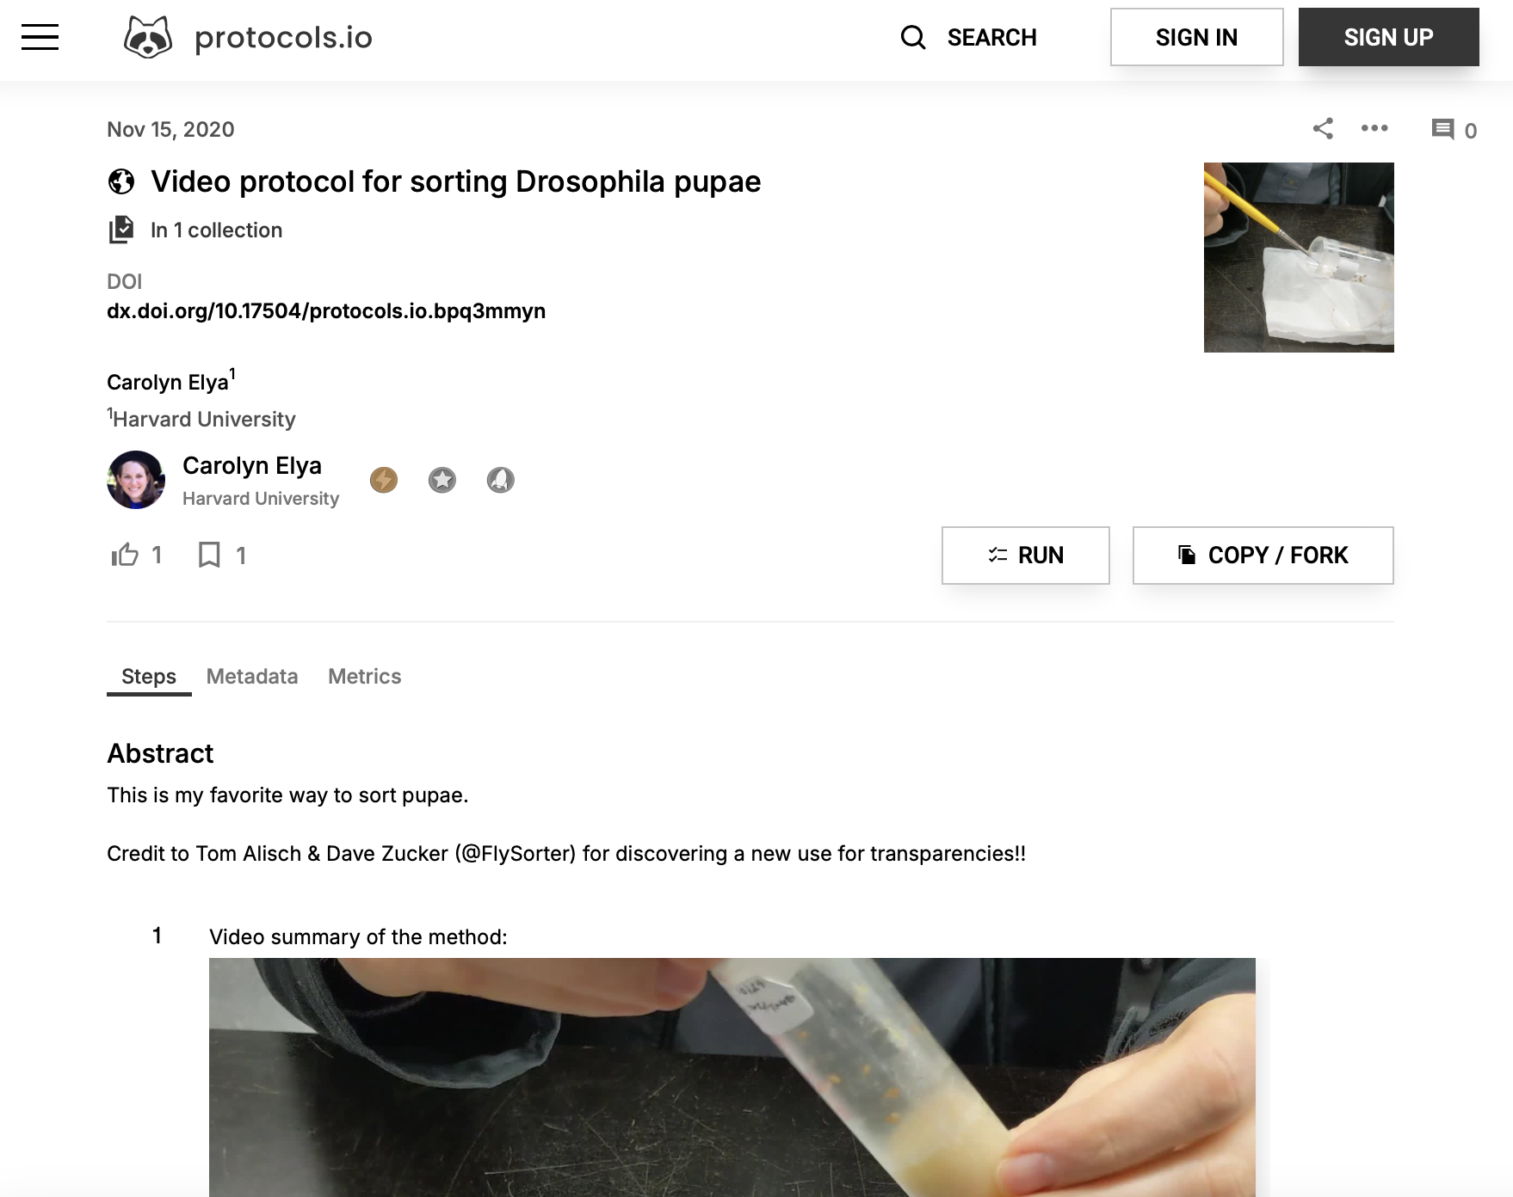
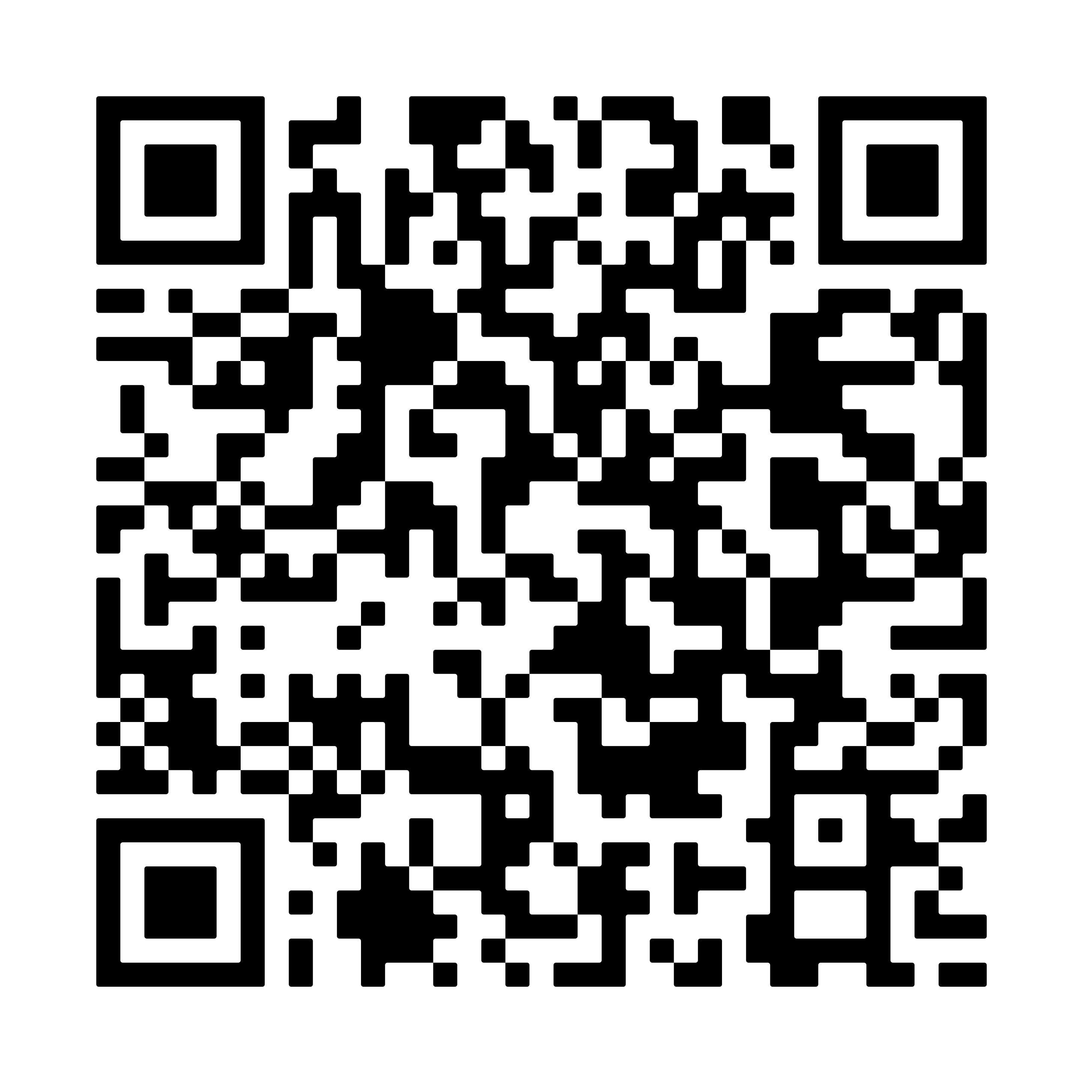
Part 1: Example #2 – how FAIR is it?
Link

Slide 9
Part 1: Minimum guidelines for integrating FAIR video materials
Findable
Put the video link in the DOI record and vice versa
Choose your video host thoughtfully, considering target audience & longevity
Accessible
Ensure access type and language are defined in the hosting metadata
Create a transcript or summary of the video for longevity, or consider hosting a download of your material
Interoperable
Add a transcript to your DOI record - .srt, .txt
Use common containers for downloadable content - .mp4, .mov, etc.
Reusable
Choose a license for your material – remixing is a common term on video hosting platforms
Understand requirements for tagging AI content

Slide 10
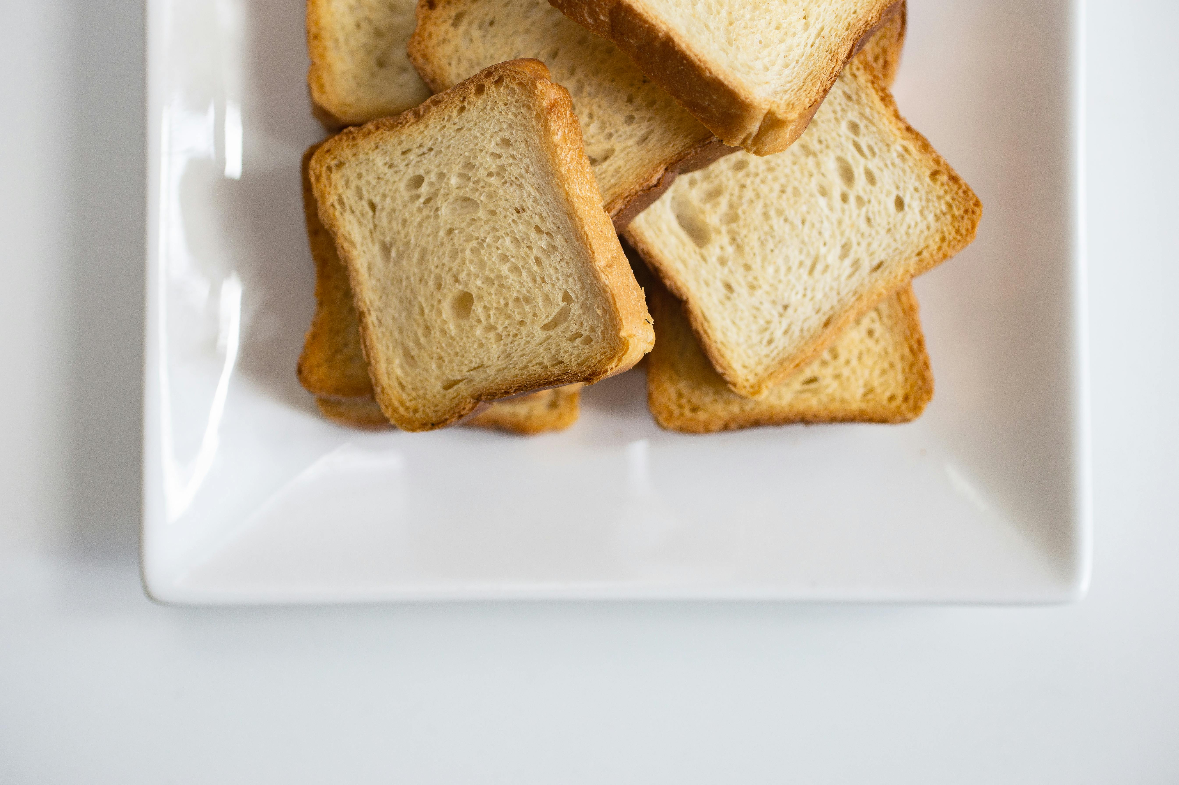
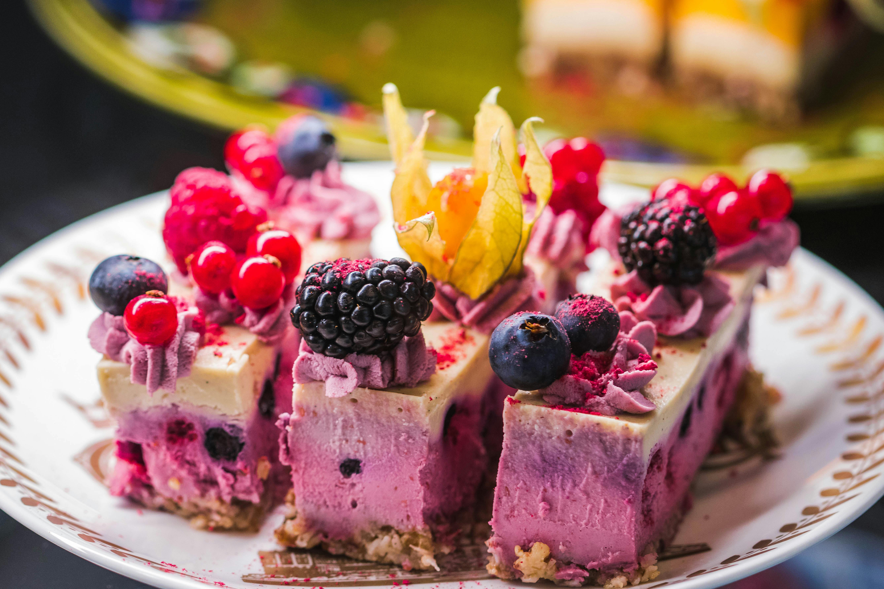
Part 2: Creating FAIR video learning materials
Minimum guidelines
Creating FAIR video learning materials
Video production is beyond the scope of this course :(

Slide 11
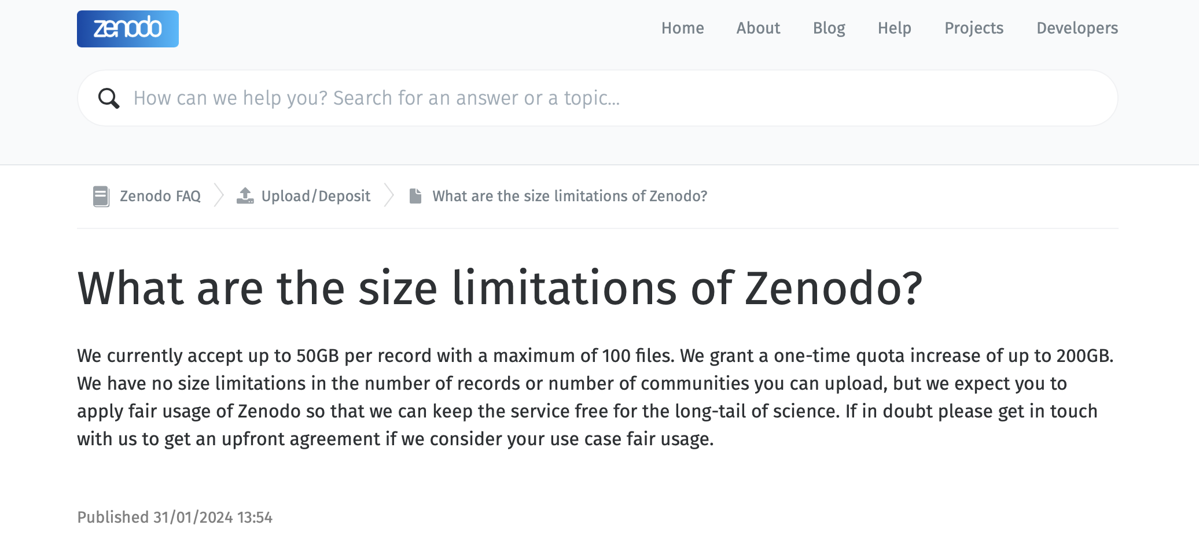
Part 2: Creating FAIR video learning materials
🪄
✂️
🍿
Create
Edit
Release
Capture:
Zoom
Powerpoint
Your smartphone
OBS Studio
Open material:
Pexels
Pixabay
Hosting options:
YouTube
Vimeo
Nextcloud
Google Drive
Zenodo*
Open source:
Blender
Kdenlive
OBS Studio
Proprietary:
iMovie
Adobe Premiere
Many others

Slide 12
Part 2: Creating FAIR video learning materials
Barriers to creating FAIR video learning material include time, skill, knowledge, and control.
It seems very difficult
Time consuming
Proprietary software
Specialized file formats
Knowledge barrier to entry
3rd party hosting
AI TOOLS
Technical knowledge
Difficult to edit and update

Slide 13
Part 2: Creating FAIR video learning materials
🪄
✂️
🍿
Create
Edit
Release
Capture:
Zoom
Powerpoint
Your smartphone
OBS Studio
Open license:
Pexels
Pixabay
Hosting options:
YouTube
Vimeo
Nextcloud
Google Drive
Zenodo*
Open source:
Blender
Kdenlive
OBS Studio
Proprietary:
iMovie
Adobe Premiere
Many others
AI TOOLS
So what?

Slide 14
Part 2: Discussion – automating education
Ask ChatGPT
to create a
script for an intermediate level course module
Ask Microsoft text to speech to optimize & deliver the training
Use YouTube Analytics to evaluate most-watched video segments
Use ChatGPT to create a video script & powerpoint
Use Capcut to edit the video footage
Generate captions with OpenAI’s Whisper

Slide 15
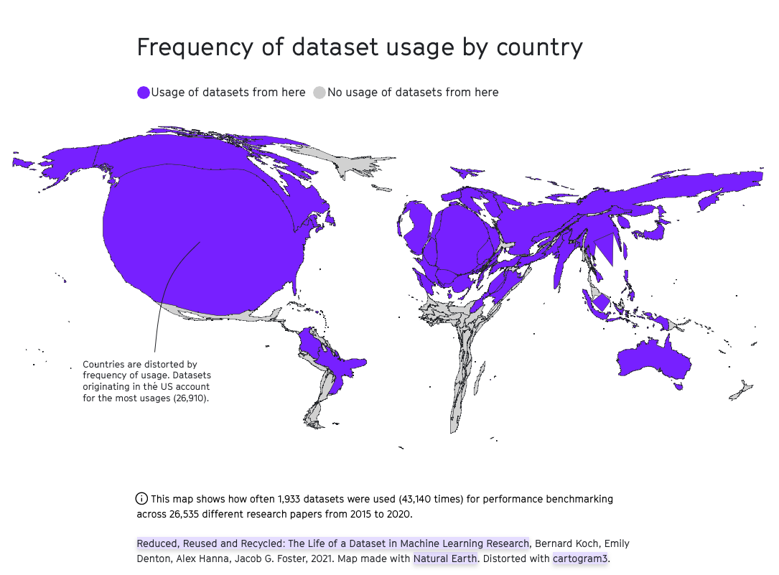
Part 2: AI literacy for FAIR video learning materials
Is the output of AI tools consistent with FAIR principles to improve discoverability and reproducibility?
Need active and responsible choice in using AI tools within higher education & lifelong learning
Normative vs. descriptive view
Guiding question: Should AI tools be used here?
Image: Mozilla internet health report
Slide adapted from Virginia Dignum lecture – Beyond the AI hype: balancing innovation and social responsibility

Slide 16
Part 3: Discussion – automating education
Ask ChatGPT
to create a
script for an intermediate level course module
Ask Microsoft text to speech to optimize & deliver the training
Use YouTube Analytics to evaluate most-watched video segments
Use ChatGPT to create a video script & powerpoint
Use Capcut to edit the video footage
Generate captions with OpenAI’s Whisper
How might using AI tools like this affect learning?
What biases might this genAI output be subject to?
Where would you not want to use AI tools?
Where could AI tools help you in developing learning materials?

Slide 17
Part 4: Exercise – 20mins
Lets add some FAIR videos to our training!
Refer to the course website (exercise 6.3) and choose your own adventure
Toast mode: Sample video
Konditori mode: Film yourself

Slide 18
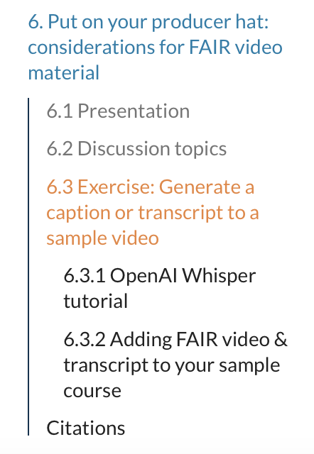
Part 4: Exercise – improve FAIRness by generating a transcript
Recommended route:
During the course:
Navigate to the whisper container
https://whisper-ai.serve.scilifelab.se/
Upload your video file
Select the output format(s) - .txt for transcript and .srt for captions
Submit the file
When the file has completed transcription, the output will download to your computer.

Slide 19

Part 4: Exercise – improve FAIRness by generating a transcript
Check your transcript!
The word error rate (WER) for the large Whisper model is 4.1% for English and 7.6% for Swedish.
Is it accurate?
Is it usable?
How does it help me achieve FAIR learning aims?

Slide 20
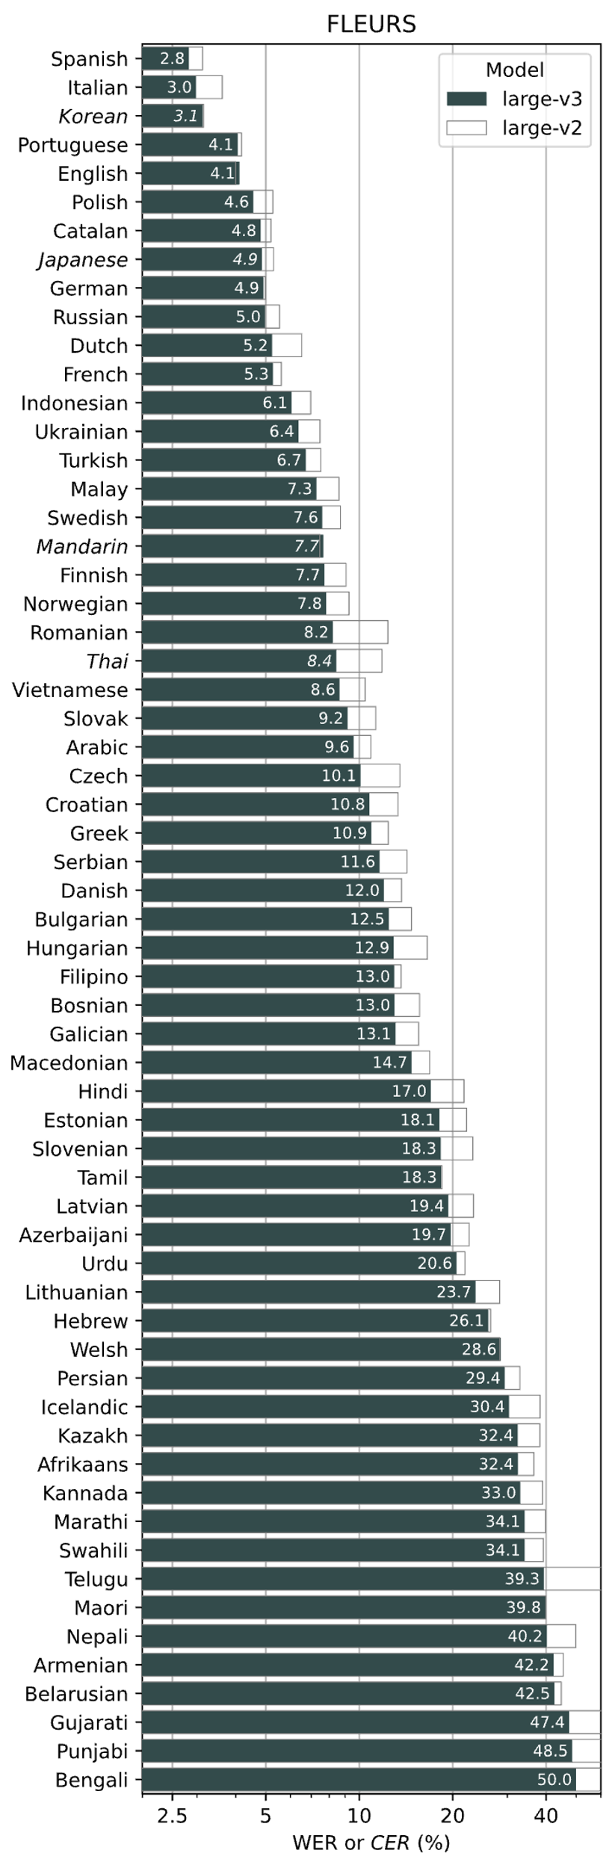

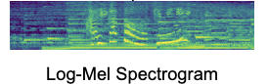
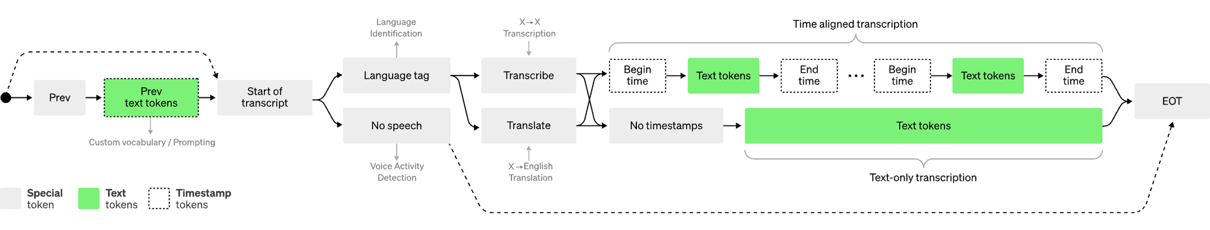
Part 4: Exercise – what happened?
What happens under the hood :: HTTPS://DOI.ORG/10.48550/ARXIV.2212.04356
audio input
decoder
30s chunks of audio are transformed to digital data
Predicts the words based on the training data sets* and produces the output
Translates the spectrogram into numerical representation
The quick brown fox…
encoder
Data sets: scraped web text, YouTube video transcriptions, podcasts¹
This process is repeated for the length of the audio:
Sources:
https://www.theverge.com/2024/4/6/24122915/openai-youtube-transcripts-gpt-4-training-data-google
https://web.archive.org/web/20230820005801/https://openai.com/research/whisper
https://github.com/openai/whisper

Slide 21
Part 4: Exercise
Integrate a video into your course page:
You can use the sample video on youtube to embed
Feel free to upload your own video to your host of choice, but we will not have time to watch these in the presentations ☺
2. Attribute the video or choose a license
3. Add your caption file!

Slide 22
Part 5: Resource & Reading List
Algorithms of Oppression - Safiya Umoja Noble
Extended reading: An Intersectional Physics Identity Framework for Studying Physics Settings – Angela Johnson
Artificial Intelligence and Learning Futures - Stefan Popenici
Beyond the AI hype: balancing innovation and social responsibility - Virginia Dignum

